Slide 1

180Sport Web app

Slide 2
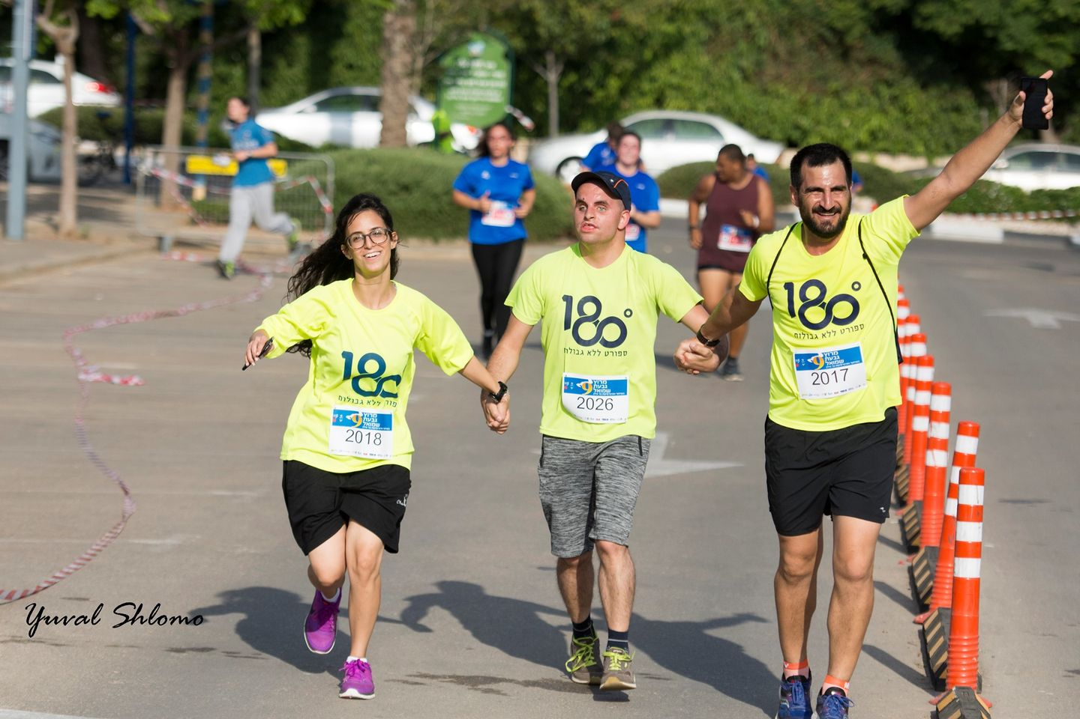

180Sport
180° is a social organization aimed at empowerment and social integration of people with disabilities through sport and educational programs

Slide 3




Frontend
Framework
Technologies
Backend
Database
Vue.js 3
A Progressive Javascript framework
Quasar
front-end framework with Vue.JS components
Python + Flask
Flask is a micro framework. Will be used for API calls to the database
SQL
A database query language.

Slide 4
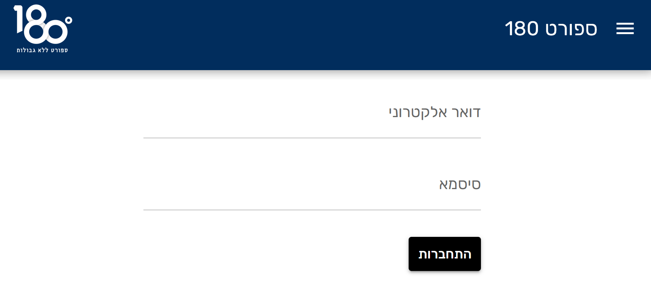

Login and Types of users
Once the user logs in, he will be redirected to his own personal area.

Slide 5
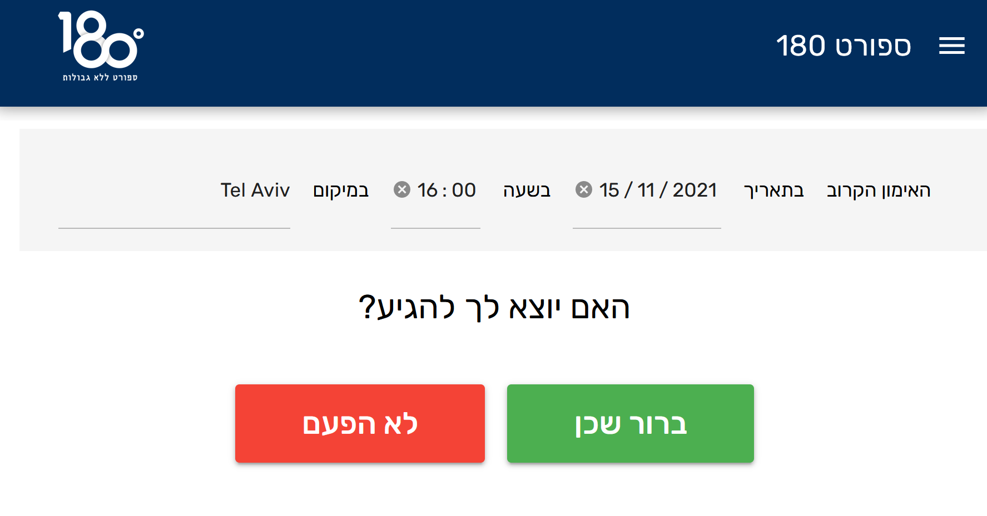
01
Trainees and Volunteers
Can only see their next training session, and mark their willingness to attend

Slide 6
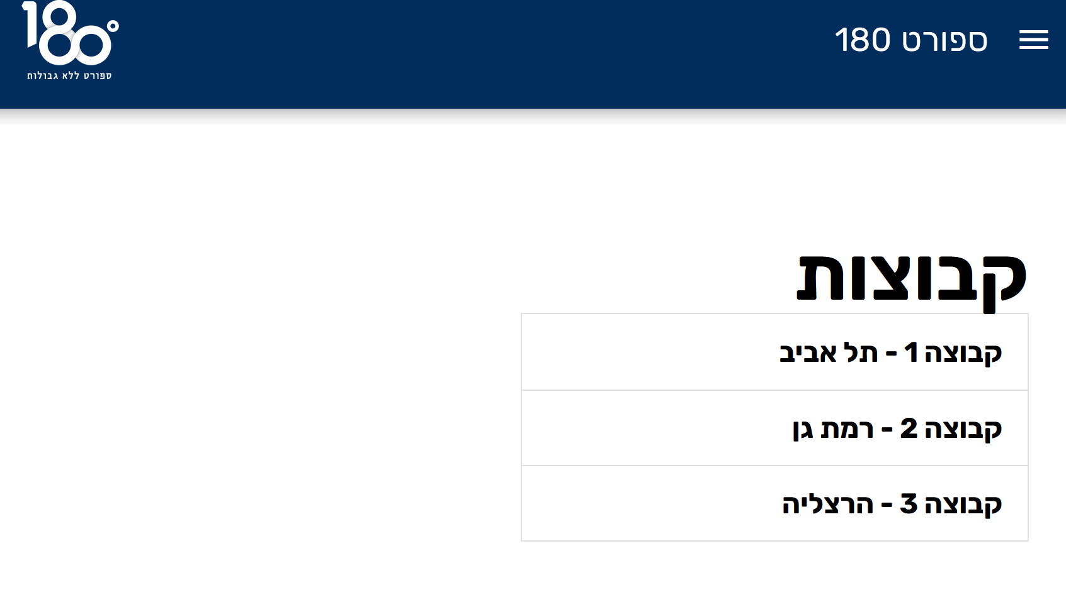
02
Trainers
Can mark attendance
Change training location and time
See messages by trainees
Send messages and change group description

Slide 7

03
Admins
Can see and edit the list of all users and groups
Change training location and time

Slide 8
Accessability
*
Planned accessability features:
Hebrew and English
Alt text and support for blind users
Keyboard-Only friendly!
Variable sizes for mobile, desktop, and others.

Slide 9
Thank you!

